Slide 1
Business Opportunities in Hyderabad
Manoj Ragala
16/11/2020

Slide 2
Introduction
Utilizing the Location based and venue related data for Hyderabad city, Perform an analysis to find and report different business opportunities location wise in Hyderabad.
One can make use of this analysis to get insights and ideas about where to start the business within Hyderabad.
Helps the people to make better decisions about their business faster.

Slide 3
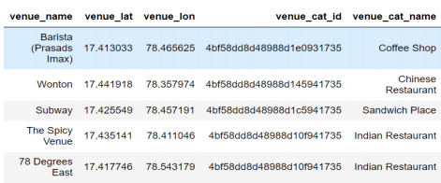
Data Collection and Curation
Create a Dataset having 2 columns Neighbourhood and section of the city.
Using geopy library fetch the latitudes and longitudes of different neighbourhoods.
Then we can use the Foursquare API to get the different venue details around each location.
The dataset has 3625 rows and 11 columns.

Slide 4
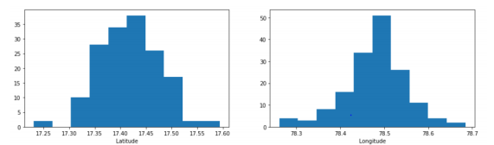
Exploratory data Analysis
Latitude and Longitude distributions of neighbourhoods in Hyderabad.

Slide 5
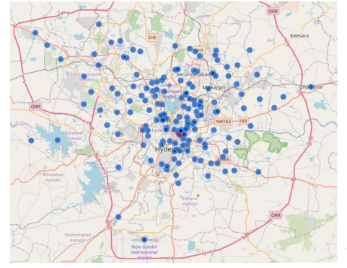
Distributions of neighbourhoods across the city

Slide 6
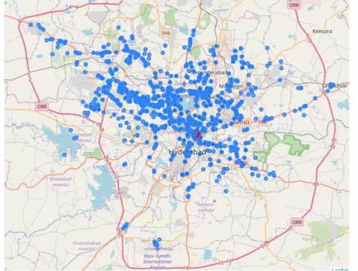
Distribution of venues spread across the city.

Slide 7
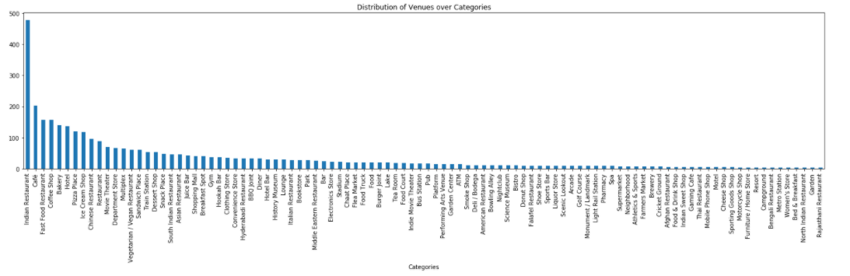
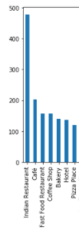
There are around 180 different venue categories, Lets look at how they are spread across the city.
Insight you can get from this
is that there are more number
of Indian Restaurants.

Slide 8
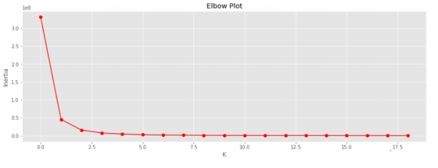
Clustering
standardize the dataset and create an elbow plot to get an idea about number of clusters we can create.
From this figure we can confidently create 4 to 5 clusters.

Slide 9
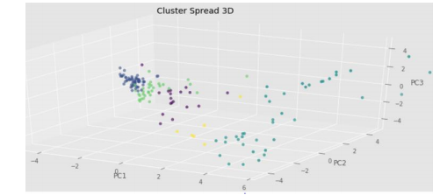
3D Cluster Plot
Applying Kmeans Clustering on the dataset will create 5 clusters of the neighbourhoods.
Using PCA algorithm we can reduce the dimensionality of the dataset.
lets create 3 principal components and visualize these clusters.

Slide 10
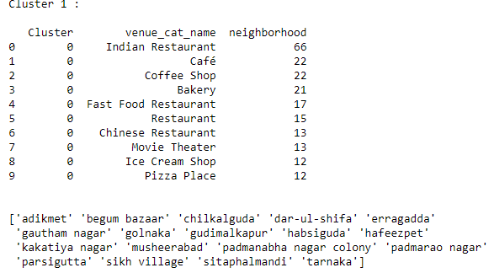
Cluster 1
let’s look at how the neighbourhoods within each cluster and major venue contributors per cluster.

Slide 11
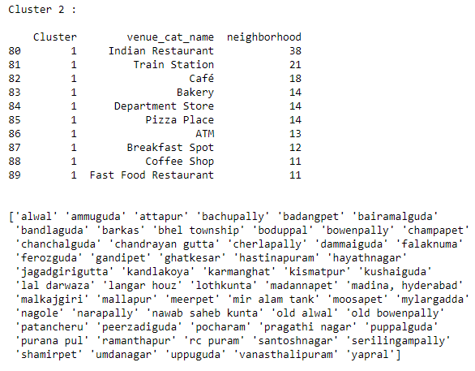
Cluster 2

Slide 12
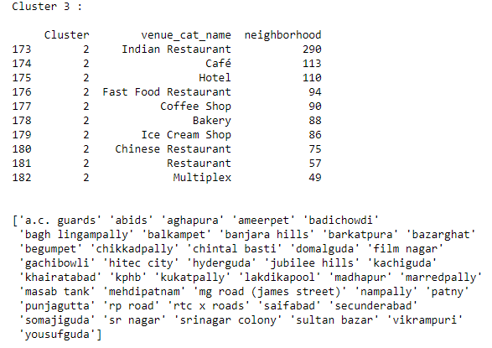
Cluster 3

Slide 13
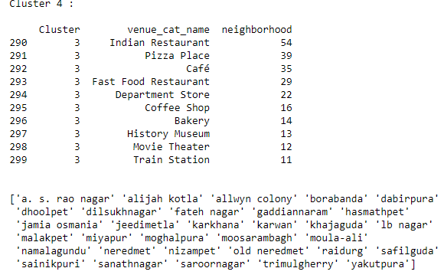
Cluster 4

Slide 14
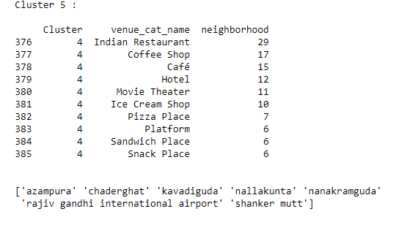
Cluster 5

Slide 15
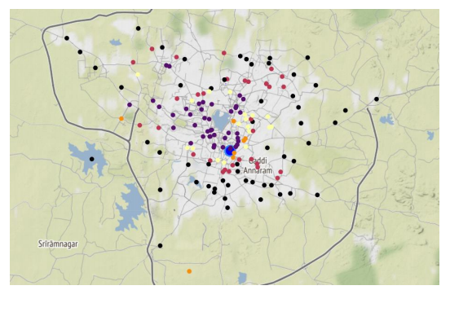
Cluster Map
Let’s look at how neighbourhoods were clustered geographically.

Slide 16
Conclusions
There is a pattern in how the clusters were grouped, the clusters have spread from center to outside of the city in a layered fashion.
It’s interesting to see that neighbourhoods of Old city away from City central were grouped into a cluster also neighbourhoods away from the center were grouped into a cluster.
Though geographically near, neighbourhoods got clustered depending on the kind of venues they have.

Slide 17
Insights
1.) After doing the analysis its evident that Hyderabad has high density of food related venues, they are everywhere.
2.) For someone who wants to start a food related business it would be great for them to open their restaurant in above mentioned cluster 3 neighbourhoods like Gachibowli, Hitech City, Jubilee hills, Film nagar.
3.) For others who are quite not sure, they can start a Hotel in Cluster 3 or Cluster 4 neighbourhoods, or they can even start restaurants in places where they are scarce like in cluster 5 neighbourhoods.
Since the food related venues are ubiquitous, it’s better to think about other businesses like super markets, theatres, small scale markets etc

Slide 18
Future Directions
We can extend this analysis by getting the population data per neighbourhood and do further analysis to understand the customer base for each kind of business.
We can combine most trending venues data with the population data to understand what makes a successful business.

